Slide 1
Final Project
James Du, Dale Deans and Cynthia Scotton
IST 659 Data Administration Concepts
and Database Management
Professor Gregory Zink
June 18, 2023
Syracuse University

Slide 2

Service that Connects Freelance Tutors with Individuals in Need

Slide 3

Index
Slide 4 …...................................Project Overview
Slide 5 …...................................Stakeholders
Slide 6 …...................................Conceptual Model
Slide 7 …...................................Logical Model
Slide 8 – 14 …............................Tables
Slide 15 – 18 …..........................Forms
Slide 19.…..................................Business Questions
Slide 20 –27 ..............................code and output of Business questions

Slide 4

Project Overview
Our goal is to create a functional database and ultimately service that would match up tutors with clients.
To achieve this, we have clients create a ‘job posting’ with certain criteria, to which clients and the tutors can set up an appointment where the client receives the service they requested.
Some auxiliary information we included are:
a rating table where the client can rate the appointment/transaction on an arbitrary scale which can be referenced in a lookup table.
Overall, our database includes six unique tables with the major tables having dozens of entries to ensure our constraints and fringe cases are worked out properly.

Slide 5

Software engineers/maintenance
End-users (clients and freelance tutors)
Potential business partners
Potential investors
Stakeholders

Slide 6
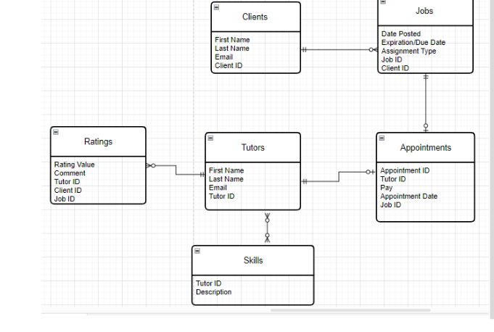
Conceptual Model
The conceptual model
Represents the overall structure of data required to support the business requirements of TutorMatch

Slide 7
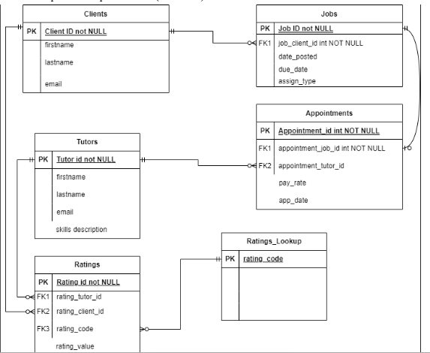
Logical Model
The logical model is
•a relational model of SQL tables.
•Used to assist in program planning, implementation, management, evaluation and reporting of TutorMatch activities.

Slide 8
Tables
Tables are:
Used for storing data in a relational database
uniquely identified by their names and comprised of rows and columns.
TutorMatch tables are:
Clients Table
Jobs
Tutors table
Appointments
Reviews
Rating Astype Lookup

Slide 9
Clients
Column Name | Data type | Properties | Description
client_id | INT | PRIMARY KEY, IDENTITY (1, 1)
firstname | VARCHAR(100) | not NULL
lastname | VARCHAR(100) | not NULL
email | VARCHAR(100) | not NULL

Slide 10
Jobs
Column name | Data type | Properties | Description
job_id | int | PRIMARY KEY, IDENTITY (1, 1 )
job_client_id | int
date_posted | date | Not NULL
Due_date | date | Not NULL
assign_type | Varchar(100)
constraint fk_jobs_job_client_id Foreign KEY (job_client_id) References CLIENTS(client_id)

Slide 11
Tutors
Column name | Data type | Properties | Description
tutor_id | INT | PRIMARY KEY, IDENTITY (1, 1) not NULL
firstname | char(50) | not NULL
lastname | char(50) | not NULL
tutor_email | varchar(50) | not Null
skills_description | varchar(50) | not NULL

Slide 12
Appointments
Column name | Data type | properties | description
appointment_id | int | Identity(1,1) Not NULL
appointment_job_id | int | Not NULL
appointment_job_id | int | Not NULL
pay_rate | money | Not NULL
app_date | date | Not NULL
constraint pk_appointments primary key (appointment_id),
constraint fk_appointments_appointment_job_id foreign key (appointment_job_id) references jobs(job_id),
constraint fk_appointments_appointment_tutor_id foreign key (appointment_tutor_id) references Tutors(tutor_id)

Slide 13
Reviews
 | Data type
review_id | INT | IDENTITY (1, 1) | Not null
review_for_user | INT |  | Not null
review_by_user | INT |  | Not null
rating | INT |  | Not null
comment | Varchar(150) |  | Not null
constraint pk_reviews primary key (review_id),
constraint fk_reviews_review_for_user foreign key (review_for_user) references Tutors(tutor_id),
constraint fk_reviews_review_by_user foreign key (review_by_user) references Clients(client_id),
constraint fk_reviews_rating foreign key (rating) references Rating_astype_lookup(rating_astype)

Slide 14
Rating Astype Lookup
Column name | Data type | Properties | description
rating_astype | INT | PRIMARY KEY, Not NULL

Slide 15
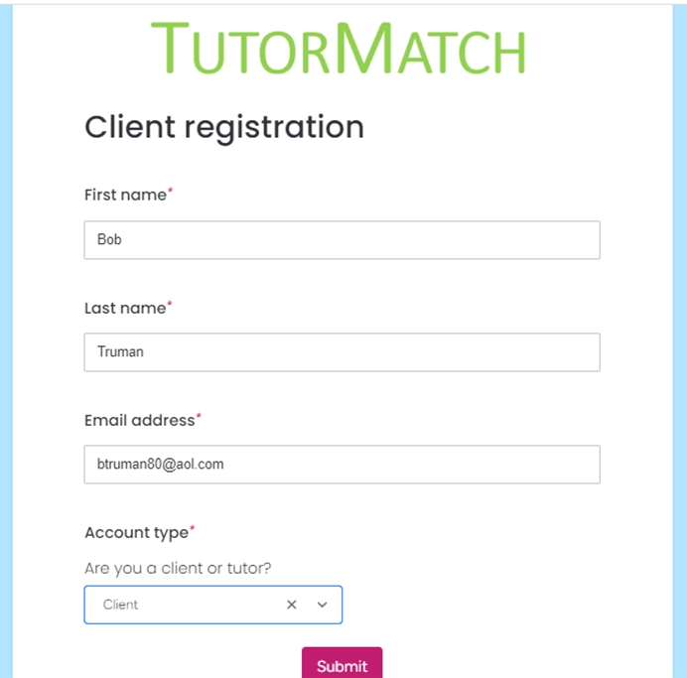
Forms

Slide 16
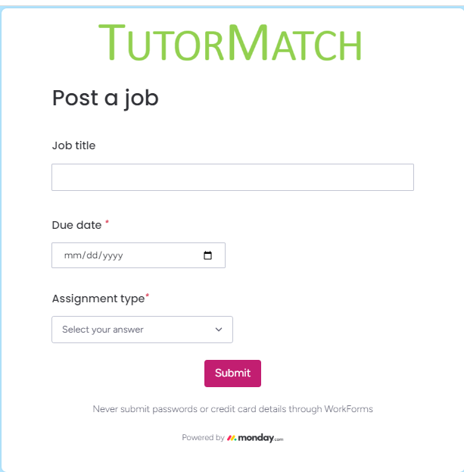
Forms

Slide 17
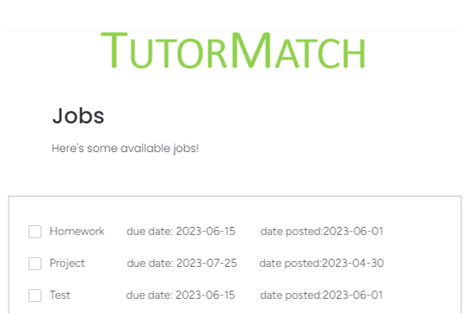
Forms

Slide 18
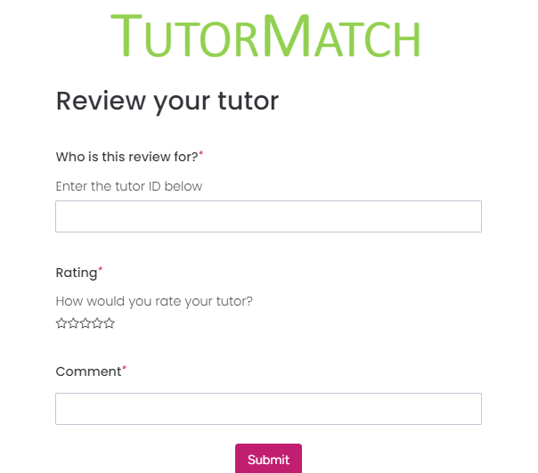
Forms

Slide 19
Business Questions
To validate the TutorMatch database and satisfy the continuous expectations of the stakeholders and shareholders, we must continuously check the efficiency of the operation to ensure that TutorMatch is performing at superior standards. Below are five questions that we expect to answer from the MOBA database:
Which individuals posted the most jobs?
Which tutor has taken the most jobs?
Who are the inactive tutors on the platform? (no jobs posted/accepted)
Create a table which includes the client information, tutor information, and appointment date.
Which tutor has the highest pay rate?
What are the average ratings for each tutor?
Create a query that returns the jobs count grouped by assignment type

Slide 20
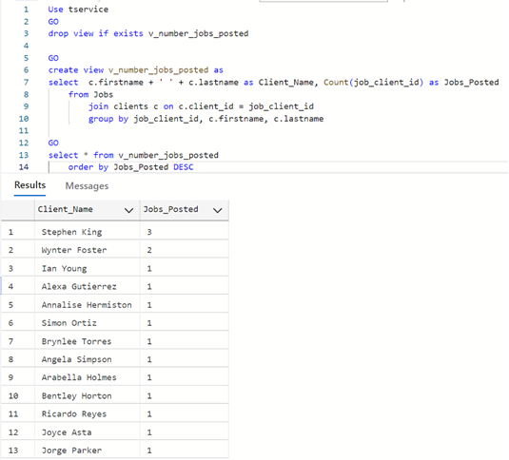
Which individuals posted the most jobs?

Slide 21
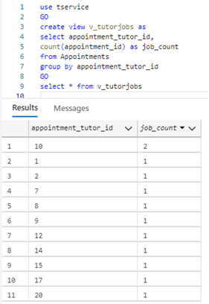
Which tutor has taken the most jobs?

Slide 22
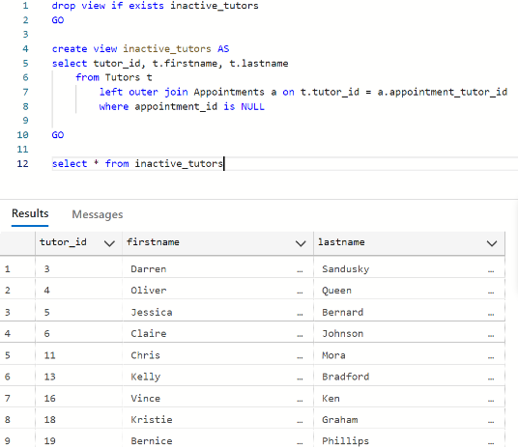
Who are the inactive tutors on the platform?

Slide 23
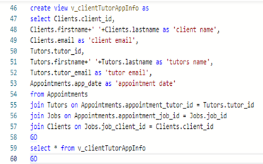
Create a table which includes the client information, tutor information, and appointment date.

Slide 24
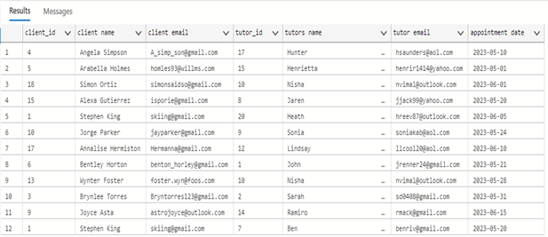
Create a table which includes the client information, tutor information, and appointment date.
continued

Slide 25
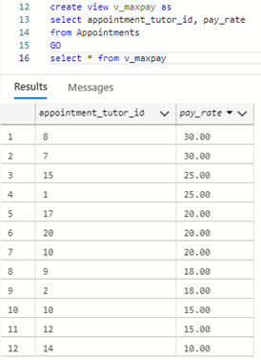
Which tutor has the highest pay rate?

Slide 26
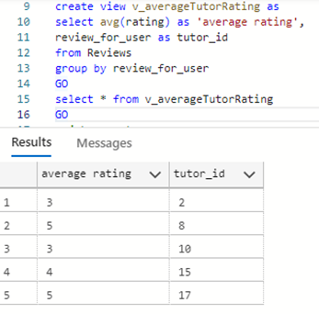
What are the average ratings for each tutor

Slide 27
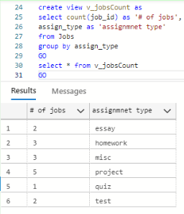
Create a query that returns the jobs count grouped by assignment type

